Slide 1
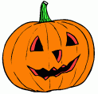
Halloween

Slide 2
On October 31, Americans celebrate Halloween
.
Halloween means „holy“ (hallow) „evening“ (een)
This is the evening before the Christian holy day of All Saints Day
Christians remember the Saints
Halloween is even oder than Christianity

Slide 3
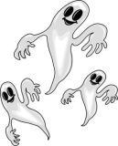
Before Christianity , people in Europe believed that on October 31
ghosts of dead people came back. To scare the ghosts, people dressed like
devils and were very noisy, They also made big fires
to keep the ghosts away.

Slide 4
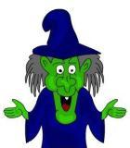
Halloween for fun
Later, people did not believe in ghosts
But they kept the day of Halloween for fun

Slide 5
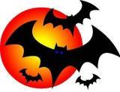
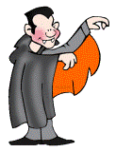
From Europe to AMERICA
Immigrants came from Europe to America and
brought with them the custom of Halloween.
Halloween has some strange symbols.....

Slide 6
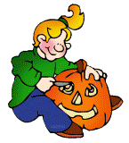
Jack - o´- lantern
One symbol is the „jack - o´- lantern“ in the window.
This is to scare the ghosts.
People cut the pumpkin, throw away all of the inside
And cut a face in it.
Then they put a cndle inside of it.
One symbol is the „jack - o´- lantern“ in the window.
This is to scare the ghosts.
People cut the pumpkin, throw away all of the inside
And cut a face in it.
Then they put a cndle inside of it.

Slide 7
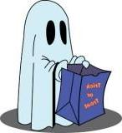
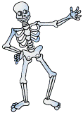
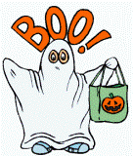
Nowdays halloween
It is very popular with the children in the United States
They wear masks and special costumes
They want to look like skeletons and ghosts

Slide 8
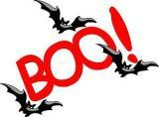
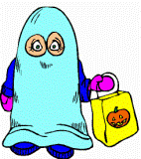
TRICK OR TREAT
Children go from house to house and say
„trick or treat!“
People give them candies, cookies and some money
When they give nothing, the children play
tricks on them

Slide 9
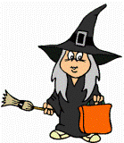
Prepared especially for pupils
of The Therapeutic Educational Sanatory
In Poľný Kesov
By Eva Molnarova

Slide 10
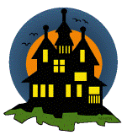
OCTOBER 2020

