Slide 1
Merry Chrystmas

Slide 2
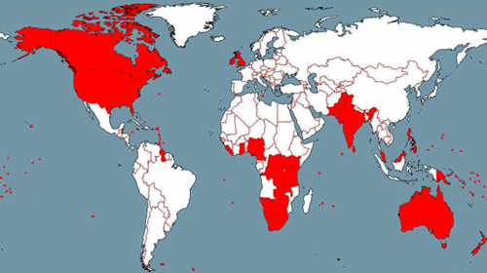
Eanglish speaking countres
Eanglish speaking countres :
New Zeland
Australia
Great Britan (United Kingdom)
United States of America
Ireland
Some countries in south africa
Canada

Slide 3
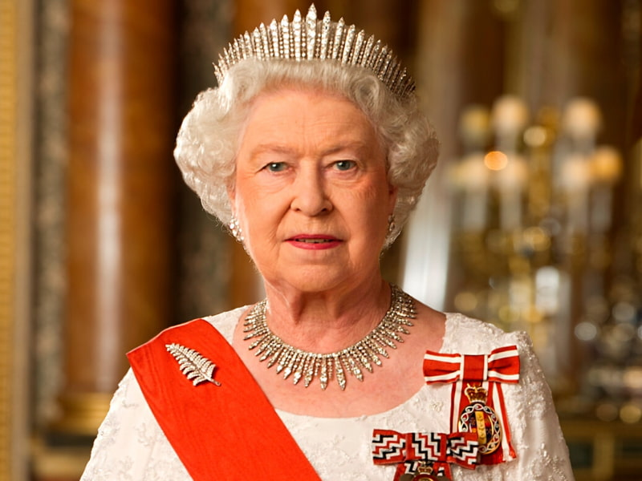
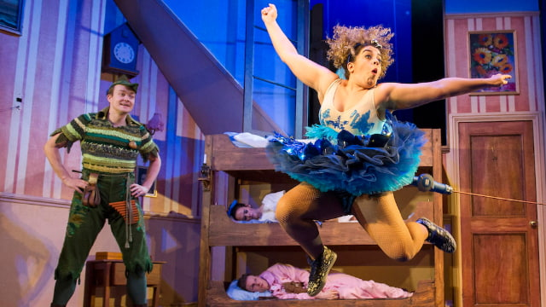
Christmas traditions in UK
Pulling Christmas crackers
Watching the Queen’s Speech
Going to the pantomime

Slide 4
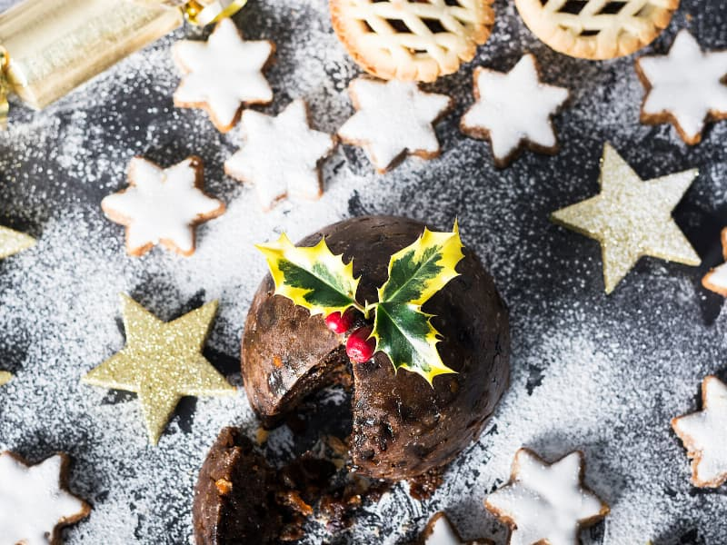
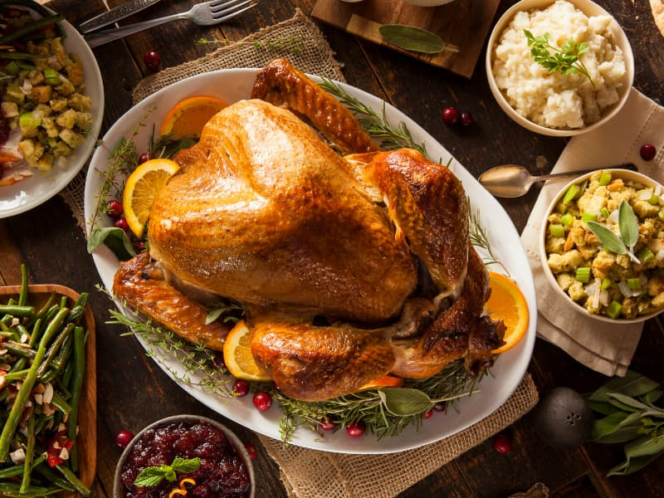
Christmas meals in UK
Pudding
Turkey
Ham

Slide 5
Christmas Traditions in USA
Watching christmas movies
Christmas tree
Christmas cards

Slide 6
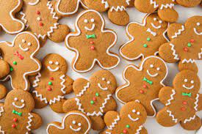
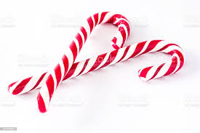
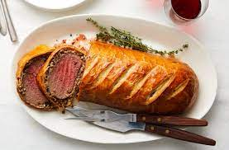
Christmas meals in USA
Gingerbread
Sugarcones
Beef wellington

Slide 7
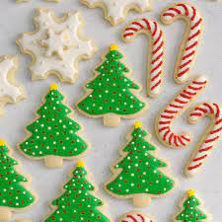
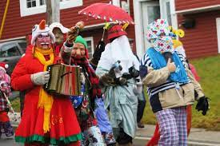
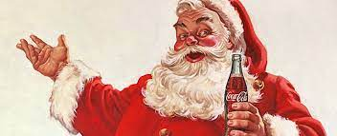
Christmast traditions in Canada
Waiting for Santa Claus
Mummering
Baking coockie with family.

Slide 8
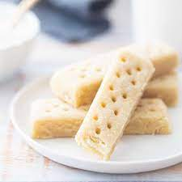
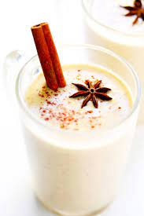
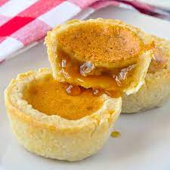
Christmas meals in Canada
Shortbread
Buttertart
Eggnog

